Slide 1
Networking Fundamentals
Foundations of Ethernet and IP

Slide 2
Class of Service
#
Layer 2 Traffic Differentiation

Slide 3
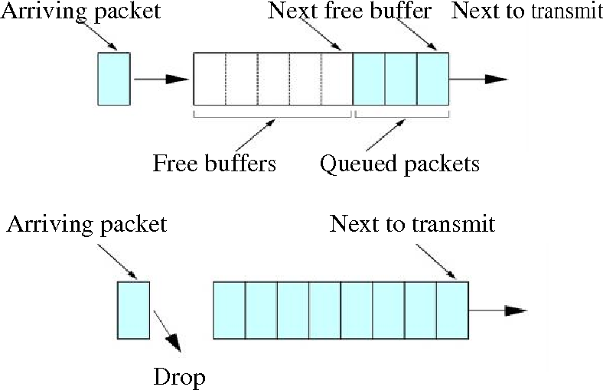
All Traffic Is Not Equal
Some traffic streams are more critical to a business than others
For example, database transactions are more important than surfing Facebook
During times of network congestion, we need to prioritize our traffic
If traffic is not prioritized, it will be dropped in an unpredictable fashion

Slide 4
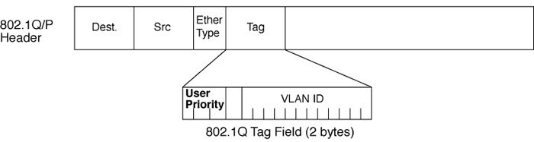
Class of Service
802.1Q header provides User Priority
3 bit CoS field – decimal 0-7
Classifies traffic to differentiate importance

Slide 5
CoS Values
Priority values can be mapped any way we want
This is the standard classification suggestion
Priority Value | Queue / Classification
Priority 0 | Background
Priority 1 | Best Effort
Priority 2 | Excellent Effort
Priority 3 | Critical Applications
Priority 4 | Video
Priority 5 | Voice
Priority 6 | Internetwork Control
Priority 7 | Network Control

Slide 6
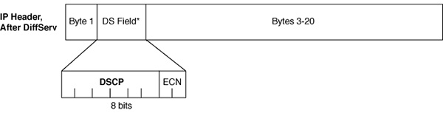
CoS vs. QoS?
Quality of Service (DSCP)
Layer 3 differentiated services field
6 bit field
In IP header
Class of Service (CoS)
Layer 2 traffic classification
3 bit field
In 802.1Q/P header

Slide 8
Networking Fundamentals
Foundations of Ethernet and IP

Slide 9
Layer 2 Concepts
#
Switching principles

Slide 10
Layer 2 Addressing
Layer 2 address is called a Media Access Control (MAC) address
MAC addresses must be unique within a broadcast domain
Layer 2 protocol data unit is a frame
MAC addresses are 48 bits long, written as 12 hexadecimal characters
01:23:45:67:89:AB
0123.4567.89AB
Broadcast MAC Address
FF:FF:FF:FF:FF:FF
Multicast MAC Address Range
01:00:5E:00:00:00 – 01:00:5E:7F:FF:FF

Slide 11
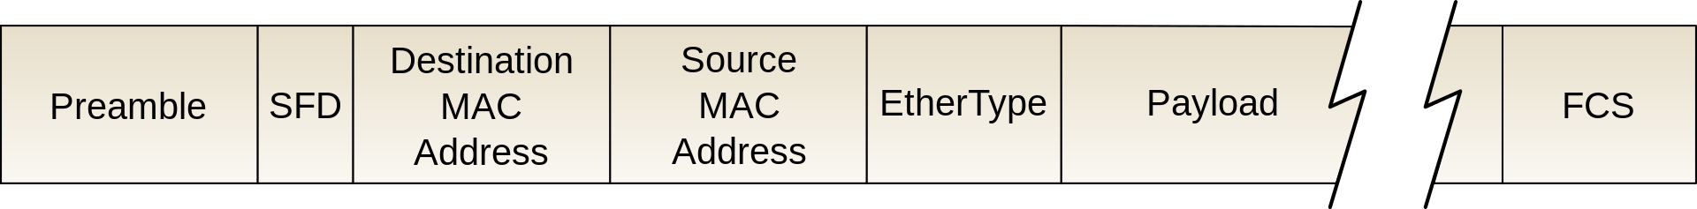
Layer 2 Header
Both source MAC address and destination MAC address are included in layer 2 header
Switches use the source MAC address in the frame to build CAM table

Slide 12
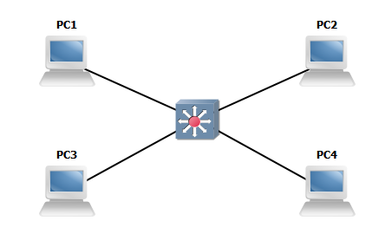
MAC Learning and Aging
A switch’s main purpose is to learn what port each MAC address lives on
Switch looks at the source MAC of incoming frames and saves to the CAM table
Entries in CAM table will age out when idle for a period of time

Slide 13
Frame Forwarding and Flooding
To forward a frame, the switch inspects the destination MAC address
If an entry exists in CAM table for destination MAC, the frame is forwarded
If entry does not exist, or the destination is broadcast, the frame is flooded

Slide 15
Networking Fundamentals
Foundations of Ethernet and IP

Slide 16
IPv4 Addressing
#
IPv4 addressing and binary conversion

Slide 17
Binary Counting
Each position from right to left is an increased power of 2
The right-most position is 2⁰, the next left position is 2¹, etc.
Add together all positions which are a 1 to convert the binary number to decimal
2⁷
2⁶
2⁵
2⁴
2³
2²
2¹
2⁰
128 64 32 16 8 4 2 1
1 0 1 0 1 1 0 0
128 + 0 + 32 + 0 + 8 + 4 + 0 + 0 = 172

Slide 18
IPv4 Address
00000000.00000000.00000000.00000000
32 bit address field
4 Octets
|-8 bits|
|------------32 bits---------------|
Comprised of a network identifier and host identifier
Definition of host and network portion is defined by a mask
1s indicate network portion, 0s indicate host portion
11111111.11111111.11111111.00000000
|---------24 bits---------|
|----------network--------|
|-hosts-|
Example 24-bit mask

Slide 19
Subnet Masks
Can be expressed in dotted decimal or CIDR (/24)
Often referred to as a prefix length
11111111.11111111.11111111.00000000
|---------24 bits---------|
|---------network---------|
|-hosts-|
172.16.10.5/21
11111111.11111111.11111000.00000000
10101100.00010000.00001010.00000101
IP Address
|-------21 bits--------|
11111111.11111111.11111000.00000000
Mask
|------- network-------|
|---hosts--|
10101100.00010000.00001000.00000000
Network ID
172.16.8.0/21

Slide 20
RFC1918 Address Spaces
Private addresses are not routable on the internet
They do not uniquely identify a device on the internet
3 private address spaces:
10.0.0.0/8
A single Class A network
172.16.0.0/12
16 contiguous Class B networks
192.168.0.0/16
256 contiguous Class C networks
Class A - /8
Class B - /16
Class C - /24

Slide 22
Networking Fundamentals
Foundations of Ethernet and IP

Slide 23
Physical Cabling
#
Copper and Fiber

Slide 24
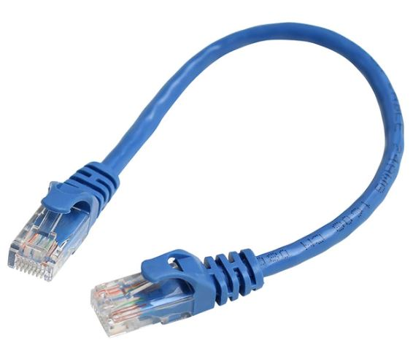
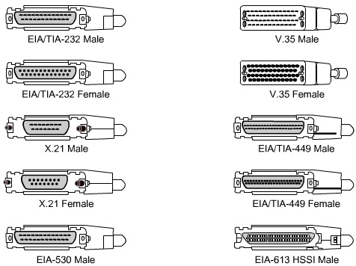
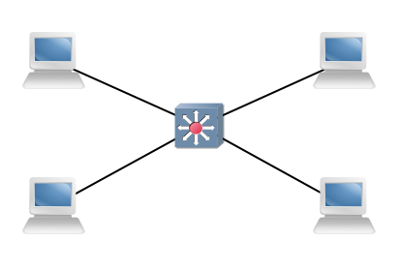

Shared Media Vs. Point to Point
Shared media ethernet networks = broadcast networks
Serial connections = point to point
Only 2 devices exist on the link

Slide 25
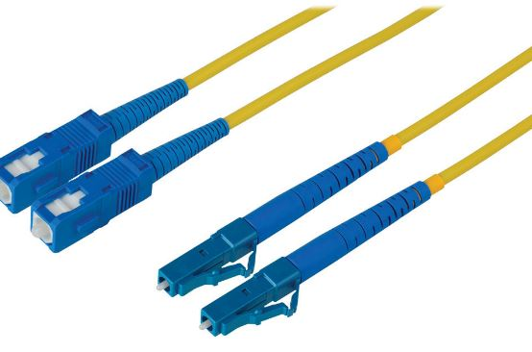
LAN Media
 | 1000BASE-T | 1000BASE-CX | 1000BASE-LX | 1000BASE-SX
Media Type | Copper | Copper | Fiber | Fiber
Standard | UTP | Coaxial | SM | MM
Max Distance | 100m | 25m | 10km | 550m

Slide 26
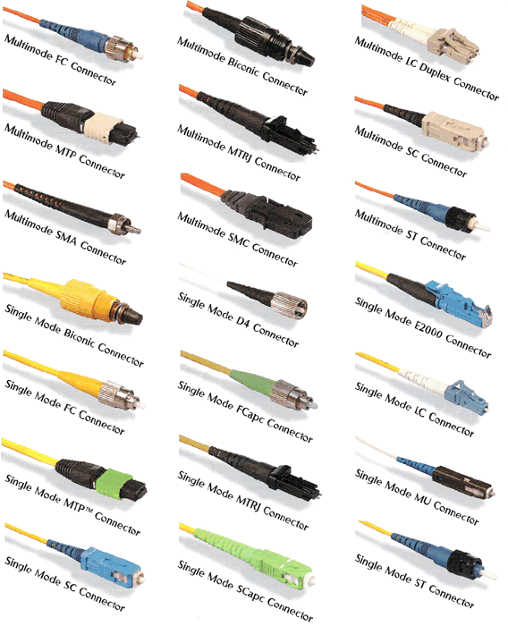
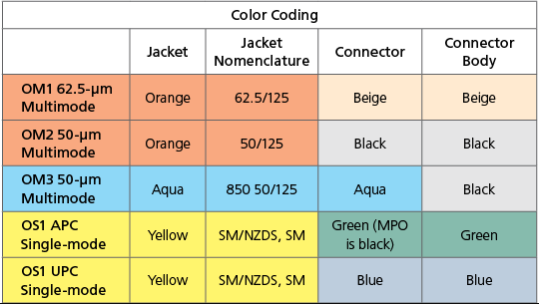
Fiber Connectors

Slide 27
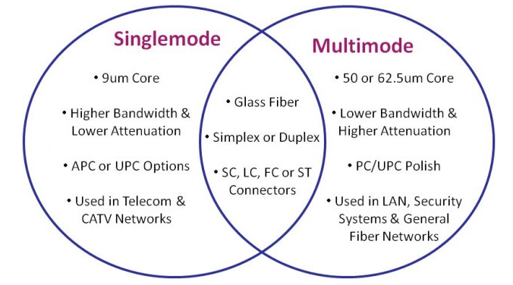
Single mode Vs. Multi-Mode
Single mode can transmit longer distances
Single mode carries 1 wavelength well
Multi-mode is typically cheaper
Multi-mode is not tuned to a single wavelength

Slide 29
Networking Fundamentals
Foundations of Ethernet and IP

Slide 30
IPv6 Concepts
#
Working with a 128-bit address

Slide 31
IPv6 Address Overview
128-bit address field
8 hextets, separated by colons
Subnet mask works exactly like IPv4, just longer
Address compression rules:
Remove all preceding 0s in a hextet
*Replace contiguous hextets of 0s with double colon ::
*Once per address
2001:0DB8:0000:0000:0000:0123:4567:89AB
|16 bits|
|---------------128 bits---------------|
2001:0DB8:0000:0000:0000:0123:4567:89AB
2001:DB8::123:4567:89AB

Slide 32
IPv6 Address Types
Global Unicast
2000::/3 – analogous to IPv4 public address space
Unique Local
fc00::/7 – analogous to RFC1918 IPV4 private address space
Link Local
fe80::/64 – not routable
Anycast
Same as global unicast but belonging to multiple nodes
Multicast
ff00::/8
Modified EUI 64
Process used to self assign a globally unique IPv6 address
Most common prefix length is /64
/64 is even recommended on point-to-point links due to EUI-64 compatibility

Slide 33
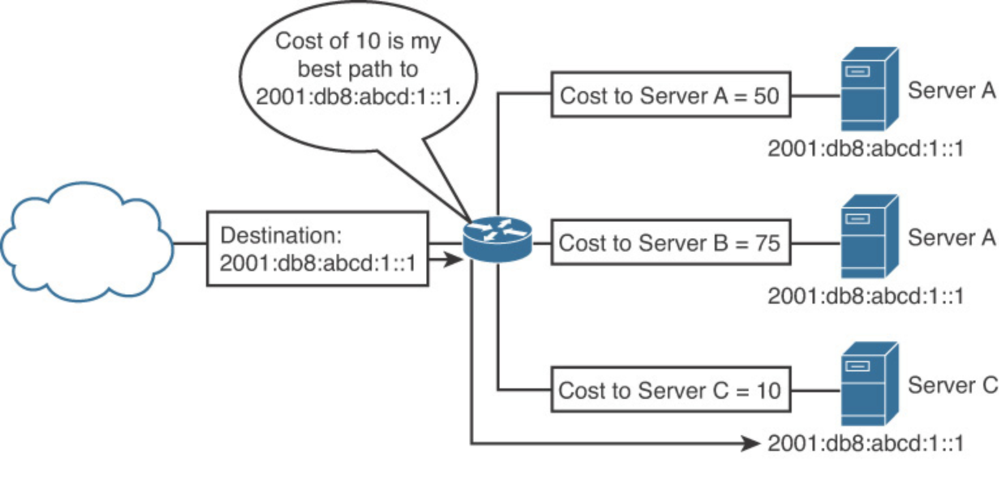
Anycast vs. Multicast
Multicast = 1 to many
Anycast = 1 to closest
Anycast uses same addresses as Global Unicast
Well-known multicast addresses:
ff02::1 - All IPv6 devices (broadcast)
ff02::2 - All IPv6 routers
ff02::5 - All OSPFv3 routers
ff02::a - All EIGRP(IPv6) routers

Slide 35
Networking Fundamentals
Foundations of Ethernet and IP

Slide 36
Network Topologies
#
Enterprise LAN and WAN design

Slide 37
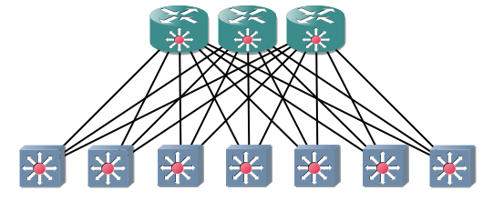
Spine-Leaf Topology
2 layers
All leaves connect to all spines
Spines are not connected
More commonly used in data centers
Spine
Leaves

Slide 38
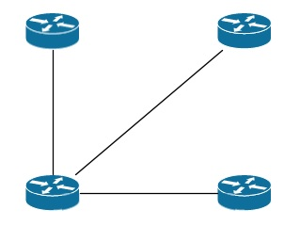
WAN Topologies – Hub & Spoke
Benefits
Fewer links
Cost savings
Simplified management
Drawbacks
Bottleneck at the hub
Possible single point of failure at hub

Slide 39
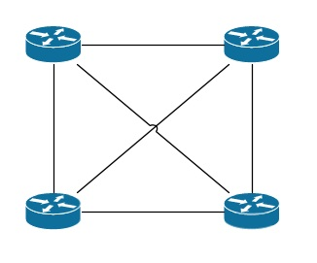
WAN Topologies – Full Mesh
Benefits
Maximum redundancy
Drawbacks
Possibly infeasible management
Most number of links
Highest cost

Slide 40
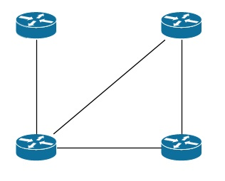
WAN Topologies – Partial Mesh
Benefits
Fewer links than full mesh
More redundancy than hub and spoke
Cost less than full mesh
Drawbacks
Management can be tricky
Some sites don’t have redundant connectivity

Slide 41
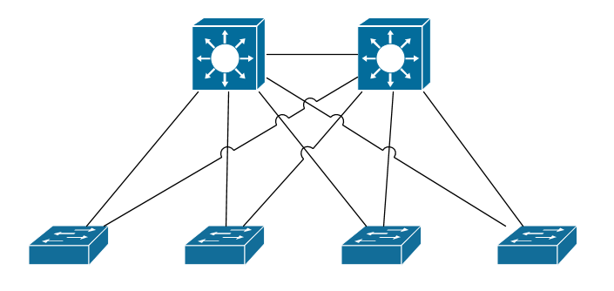
LAN Topologies – Collapsed Core
Core-Distribution
Much more typical of small-medium businesses
Usually what a small business aspires to become
Resilient and scalable
Access

Slide 42
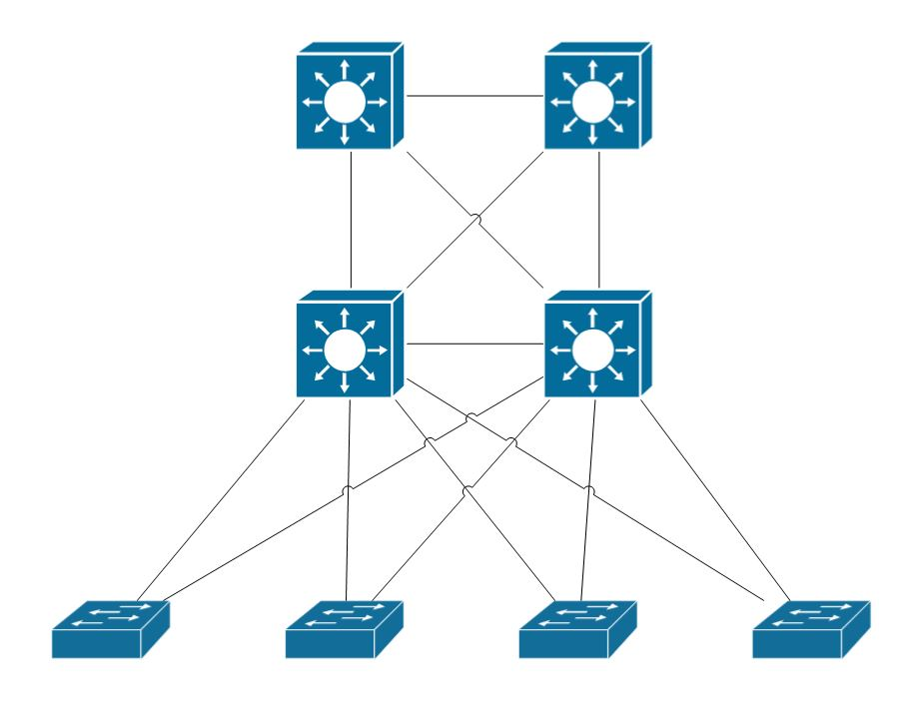
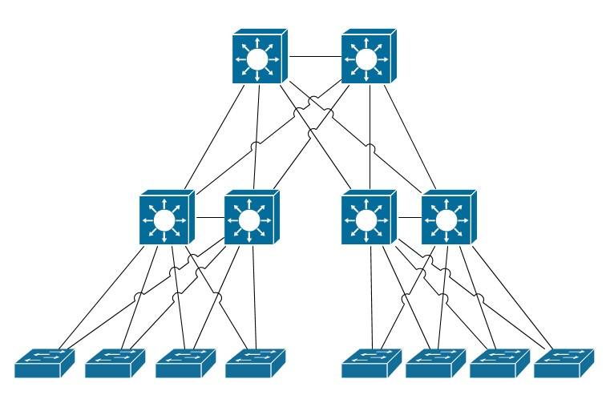
LAN Topologies – 3 Tier
The ultimate in scalability
Core
Distribution
Access

Slide 44
Networking Fundamentals
Foundations of Ethernet and IP

Slide 45
Network Terminology
#
Need-to-know terms for success

Slide 46
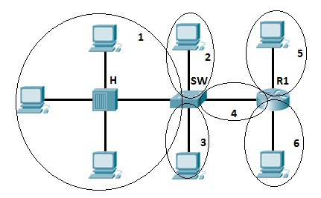
Physical – Collision Domain
When a device transmits, the entire wire’s voltage increases
A collision domain is a continuous electrically conductive wire. A hub connects multiple wires. A switch separates collision domains

Slide 47
Physical – Duplex
Duplex dictates whether a device may transmit and receive at the same time

Slide 48
Logical – Broadcast Domain
Where a hub physically connects multiple wires, a switch logically connects them
A switch uses information in the ethernet frame to re-transmit (forward) the information

Slide 50
Networking Fundamentals
Foundations of Ethernet and IP

Slide 51
Longest Match Routing
#
Layer 3 routing decisions

Slide 52
Prefix Length
The length of a subnet mask is called the prefix length
This is because the network portion of the address is called the prefix
The longer the prefix, the fewer host bits in the address
The fewer the host bits, the more specific the route
11111111.11111111.11111111.11000000
11111111.11111111.11111000.00000000
|----------26 bits----------|
|-------21 bits--------|
|----------network----------|
|hosts|
|------- network-------|
|---hosts--|

Slide 53
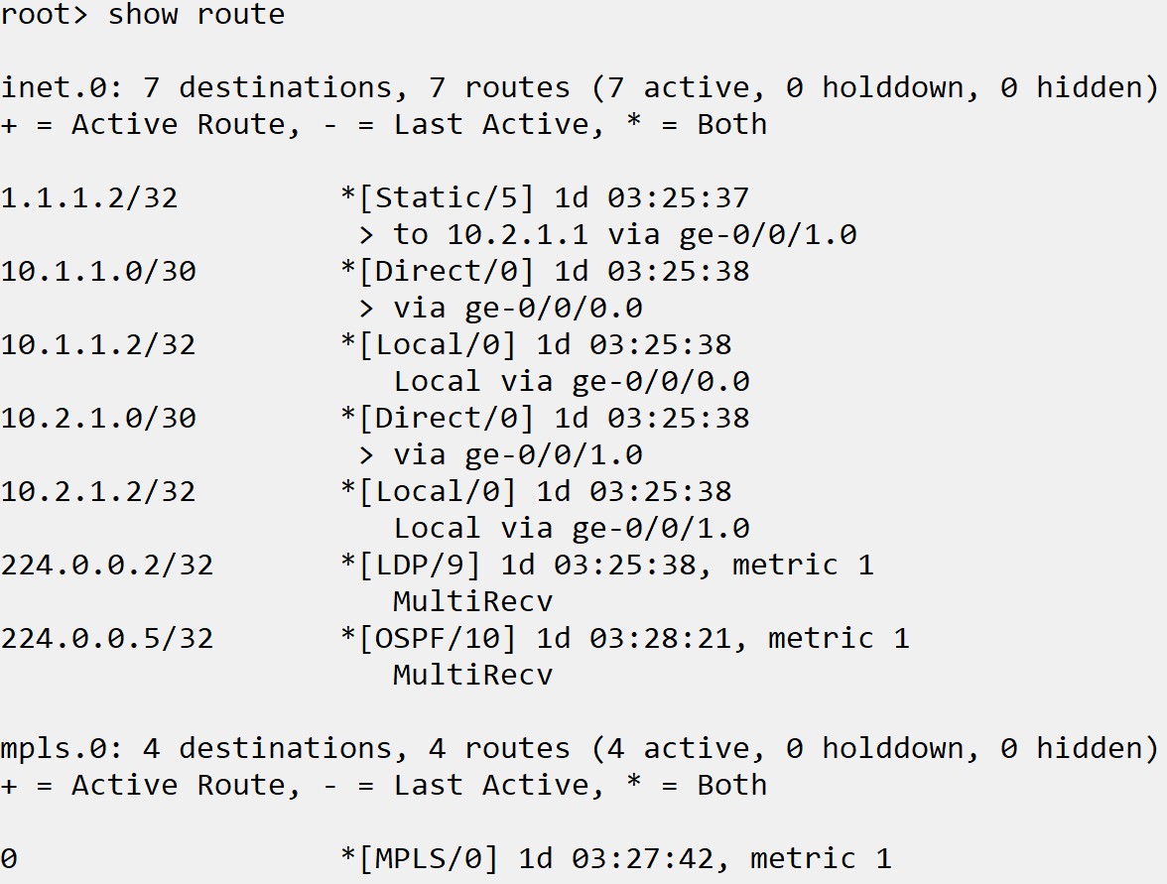
Routing Table Contents
Prefix
Protocol
Next hop
Including Interface
Age

Slide 54
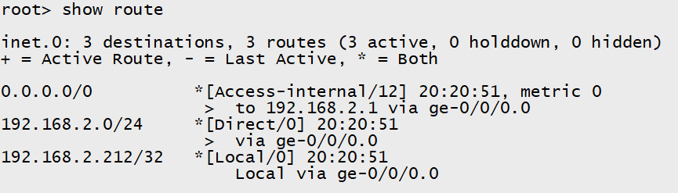
Longest Match
If multiple routing entries include the destination IP, the longest match is used
Examples:
Destination IP = 192.168.2.4
192.168.2.0/24 route is used
Destination = 172.16.0.4
0.0.0.0/0 route is used

Slide 56
Networking Fundamentals
Foundations of Ethernet and IP

Slide 57
TCP and UDP
#
Connection-oriented vs. connectionless protocols

Slide 58
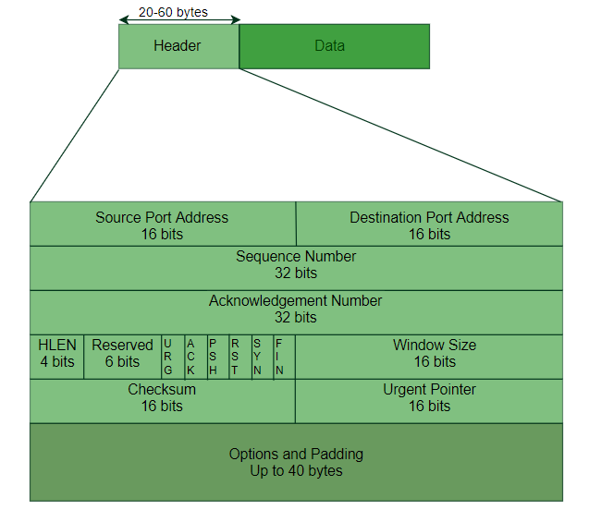
TCP: Introduction
TCP – Transmission Control Protocol
Protocol Data Unit - Segment
Header size – 20-60 Bytes
Starts with random initial sequence number
Includes source and destination IP and port

Slide 59
TCP: Flags
URG – Urgent
Process packet before any non-urgent packets
ACK – Acknowledge
Acknowledge receipt of a sequence number
PSH – Push
Packet processed immediately, not buffered
RST – Reset
Resents connection
SYN – Synchronize
Request to open a TCP connection
FIN – Finished
Indicates sender has no more data to send

Slide 60
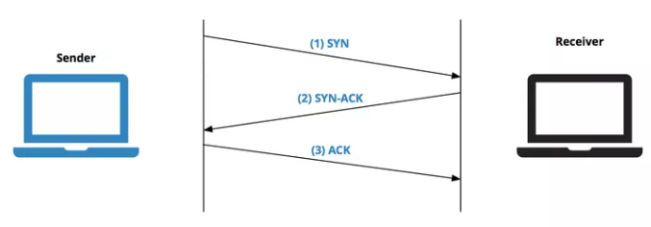
TCP: The 3-Way Handshake
Sender sends initial TCP packet with SYN flag, to request opening a connection
Receiver replies, ACK the initial SYN and sending its own SYN
Sender receives the ACK and SYN, replies with ACK to acknowledge the second SYN
Confirms 2 way communication

Slide 61
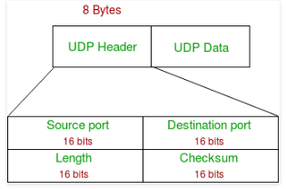
UDP: Introduction
UDP – User Datagram Protocol
Protocol Data Unit - Datagram
Header Size – 8 bytes
Includes source and destination IP and port

Slide 63
Networking Fundamentals
Foundations of Ethernet and IP

Slide 64
Network Components
#
Routers, switches and firewalls

Slide 65
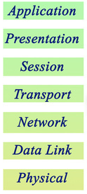
OSI Model
Communication function model for OSI protocol suite
Network engineers generally care about 1-4 then 7
Good to be comfortable with conceptualizing the layers for troubleshooting

Slide 66
Protocol Data Units
Protocols
Protocol Data Units
TCP, UDP
Segment or Datagram
IP, ICMP, OSPF
Packet
Ethernet
Frame
RJ45, 802.11
Bit

Slide 67
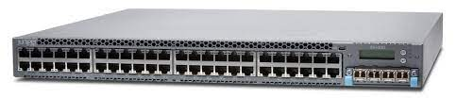
Layer 2 Switches
Separate collision domain per port
Primary job is to learn what port MACs live on
Only interact with traffic up to layer 2 of OSI model
Used for end-devices to connect into the network
Juniper EX4300-48T

Slide 68
Layer 3 Switches
Same as layer 2 switches, but include IP routing
Interact with traffic up to layer 3
Typically not as full featured as routers
Typically used as upstream switches for inter-vlan routing and policies
Juniper EX4300-48T

Slide 69
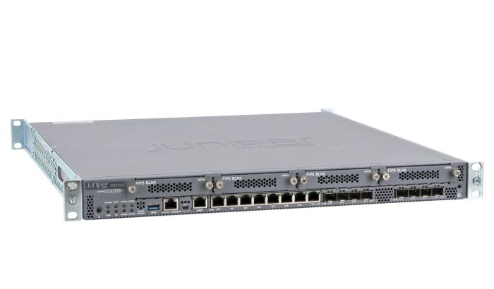
Routers
Generally better interacting with traffic at layers 3 and 4
Usually fewer ports than switches
Typically an edge device that provides more CPU intensive services
Juniper SRX345

